Slide 1

PROJECT OVERVIEW
EASY
ADVANCED

Slide 2
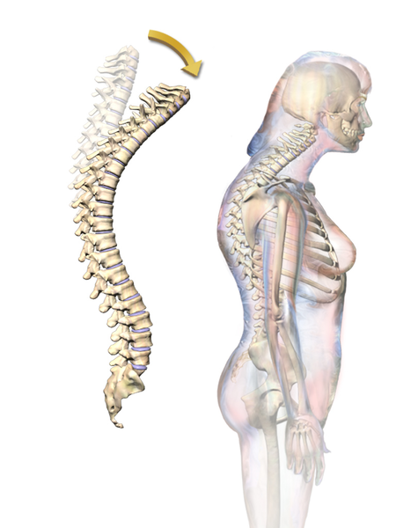
PROJECT OVERVIEW
Kyphosis is an abnormally excessive convex curvature of the spine. The kyphosis data frame has 81 rows and 4 columns representing data on children who have had corrective spinal surgery. Dataset contains 3 inputs and 1 output
INPUTS:
Age: in months
Number: the number of vertebrae involved
Start: the number of the first (topmost) vertebra operated on.
OUTPUTS:
Kyphosis: a factor with levels “absent” or “present” indicating if a kyphosis (a type of deformation) was present after the operation.
Link to dataset: https://www.kaggle.com/abbasit/kyphosis-dataset
Source: John M. Chambers and Trevor J. Hastie eds. (1992) Statistical Models in S, Wadsworth and Brooks/Cole, Pacific Grove, CA.
Photo Credit: https://commons.wikimedia.org/wiki/File:Kyphosis.png

Slide 3
K NEAREST NEIGHBORS (KNN) ALGORITHM
EASY
ADVANCED

Slide 4
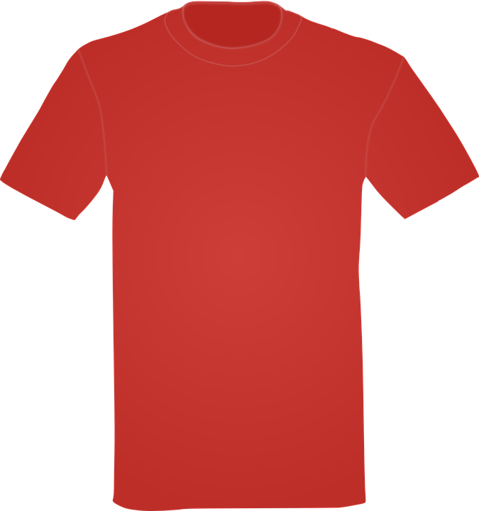

K NEAREST NEIGHBORS (KNN): INTUITION
K-Nearest Neighbors (KNN) algorithm is a classification algorithm
KNN works by finding the most similar data points in the training data, and attempt to make an educated guess based on their classifications
L
SIZE: SMALL
SIZE: LARGE
S
150 160 170 180
HEIGHT (CMS)
?
55 60 65 70 75
WEIGHT (KGS)

Slide 5
Select a value for k (e.g.: 1, 2, 3, …..)
Calculate the Euclidian distance between the point to be classified and every other point in the training data set
Pick the k closest data points (points with the k smallest distances)
Run a majority cote among selected data points, the dominating classification is the winner. Point is classified based on the dominant class
Repeat
K NEARSET NEIGHBORS (KNN): ALGORITHM STEP

Slide 6

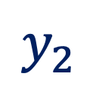

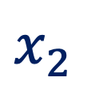
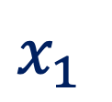
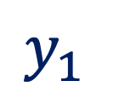
EUCLIDEAN DISTANCE: INTUITION
$$Euclidean Distance= \sqrt{{\left(x_{2}−x_{1}\right)}^{2}+{\left(y_{2}−y_{1}\right)}^{2}}$$
$y_{2}$
$Point B {(x}_{2}, y_{2})$
$y_{1}$
$Point A {(x}_{1}, y_{1})$
$x_{1}$
$x_{2}$

Slide 7
K NEARSET NEIGHBORS (KNN): EXAMPLE
KNN will look for the 5 data points that are closest to the new customer data point
The algorithm will determine which category (class) are these 5 points in
Since 4 points had class “SMALL” and 1 had “LARGE”, then new customer shall be assigned small size
New Customer Information:
Height: 161
Weight: 61
Assume, k= 5
Height | Weight | T-Shirt Size | Euclidian Dist | Vote
158 | 58 | S | 4.242640687
158 | 59 | S | 3.605551275
158 | 63 | S | 3.605551275
160 | 59 | S | 2.236067977 | 3
160 | 60 | S | 1.414213562 | 1
163 | 60 | S | 2.236067977 | 3
163 | 61 | S | 2 | 2
160 | 64 | L | 3.16227766 | 5
163 | 64 | L | 4
165 | 61 | L | 4.123105626
165 | 62 | L | 5.656858249
Example Source: https://www.listendata.com/2017/12/k-nearest-neighbor-step-by-step-tutorial.html

Slide 8
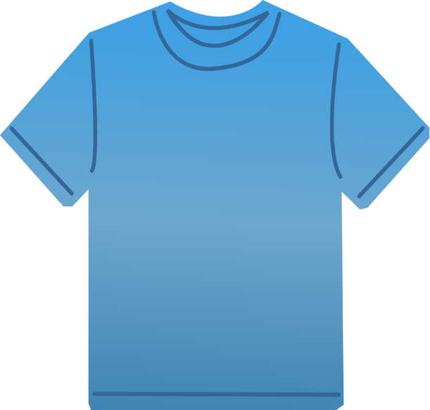
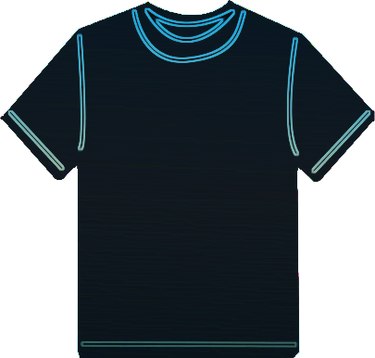
K NEAREST NEIGHBORS (KNN): EXAMPLE
Let’s understand this example visually!
SIZE: SMALL
SIZE: LARGE
L
150 160 170 180
HEIGHT (CMS)
S
POINT CLASSIFIED AS BLUE (S SIZE)
?
55 60 65 70
WEIGHT (KGS)

Slide 9
K NEAREST NEIGHBORS (KNN) ALGORITHM IN SAGEMAKER
EASY
ADVANCED

Slide 10
K NEAREST NEIGHBORS (KNN) IN SAGEMAKER
KNN in SageMaker could be used to perform simple classification or regression
Classification: algorithm finds the K-closest points to a given sample point and return the most frequent label
Regression: algorithm finds K-closest points to a given sample point and return the average value.
KNN is a lazy algorithm, it does not try to generalize the model for the entire training dataset, but it rely on neighbouring data points.
Training with the KNN algorithm has three steps:
Sampling
Dimension reduction
Index building
Sampling is used to minimize the size of dataset to optimize memory.
Dimensionality reduction is performed to:
Decrease the feature dimension of the data to reduce the footprint of the k-NN model in memory and inference latency and avoids the “curse of dimensionality”

Slide 11

K NEAREST NEIGHBORS (KNN): HYPERPARAMETERS
Full set of hyperparameters: https://docs.aws.amazon.com/sagemaker/latest/dg/kNN_hyperparameters.html
K: The number of nearest neighbors
Sample_size: The number of data points to be sampled from the training data set.
feature_dim: The number of features in the input data.
predictor_type: classification or regression
dimension_reduction_target: The target dimension to reduce to.

Slide 12

K NEAREST NEIGHBORS (KNN): INPUT/OUTPUT
KNN supports two channels:
Train channel contains training data
Test channel to provide test scores such as accuracy for classifier or MSE for regressor
SageMaker KNN algorithm supports recordIO-protobuf or CSV formats
KNN can be used in both File or pipe mode

Slide 13

K NEAREST NEIGHBORS (KNN): INSTANCE TYPES
For KNN Training:
CPU such as Ml.m5.2xlarge
GPU such as Ml.p2.xlarge
For Inference:
GPU for higher throughput on large batches
CPU generally provides lower latency

Slide 14
CODE DEMO
EASY
ADVANCED

Slide 15
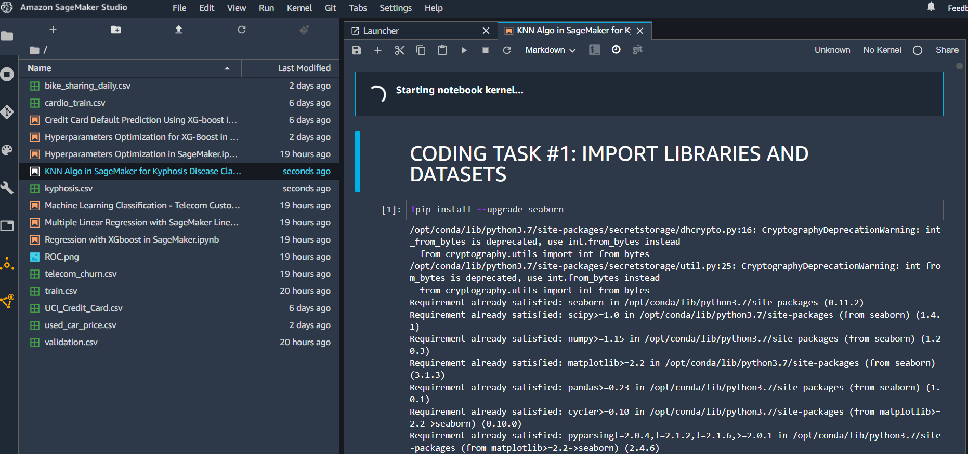
CODE DEMO

Slide 16
FINAL END-OF-DAY CAPSTONE PROJECT
EASY
ADVANCED

Slide 17
PROJECT TASKS
Using the same dataset, perform the following tasks:
Train a random forest classifier model in SKLearn and assess its performance
Plot the confusion matrix
Print the classification Report
Train a decision tree classifier model in SKLearn and assess its performance
Plot the confusion matrix
Print the classification Report
Calculate Feature Importance
Train an XG-Boost Algorithm in SageMaker
Comment on the results
Delete the endpoint

